Slide 1
Introductory Statistics
Tenth Edition
Prem Mann
Chapter 2
Organizing and Graphing Data
This slide deck contains animations. Please disable animations if they cause issues with your device.
Copyright ©2021 John Wiley & Sons, Inc.

Slide 2
Opening Example
Are you in favor of a single-payer health care system where the federal government provides coverage for everyone? Or are you opposed to such a system? Or still, are you undecided? Rasmussen Reports conducted a survey of 1000 likely voters on August 4–5, 2019 to find the answers to this question. To see the results of this survey, see Case Study 2.2.

Slide 3
2.1 Organizing and Graphing Qualitative Data
Definition
Data recorded in the sequence in which they are collected and before they are processed or ranked are called raw data.

Slide 4
Table 2.1 Ages of 50 Students
21 | 19 | 24 | 25 | 29 | 34 | 26 | 27 | 37 | 33
18 | 20 | 19 | 22 | 19 | 19 | 25 | 22 | 25 | 23
25 | 19 | 31 | 19 | 23 | 18 | 23 | 19 | 23 | 26
22 | 28 | 21 | 20 | 22 | 22 | 21 | 20 | 19 | 21
25 | 23 | 18 | 37 | 27 | 23 | 21 | 25 | 21 | 24

Slide 5
Table 2.2 Status of 50 Students
J | F | SO | SE | J | J | SE | J | J | J
F | F | J | F | F | F | SE | SO | SE | J
J | F | SE | SO | SO | F | J | F | SE | SE
SO | SE | J | SO | SO | J | J | SO | F | SO
SE | SE | F | SE | J | SO | F | J | SO | SO

Slide 6
Organizing and Graphing Qualitative Data
Frequency Distributions
Relative Frequency and Percentage Distributions
Graphical Presentation of Qualitative Data

Slide 7
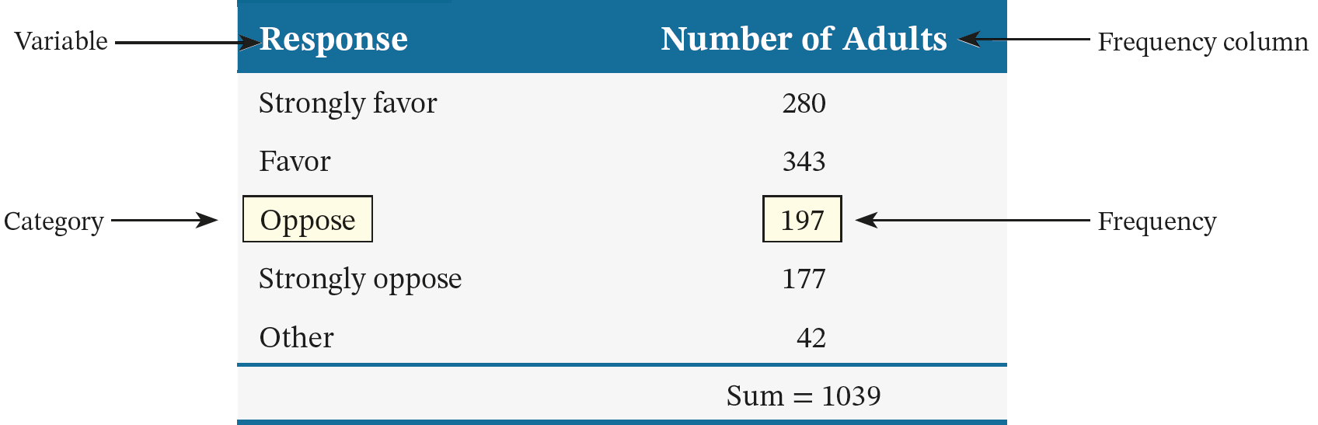
Table 2.3 Support for Proposals to Reduce use of Fossil Fuels

Slide 8
Frequency Distributions
Definition
A frequency distribution of a qualitative variable lists all categories and the number of elements that belong to each of the categories.

Slide 9
Example 2-1 (1 of 2)
A sample of 30 persons who often consume donuts were asked what variety of donuts is their favorite. The responses from these 30 persons are as follows:

Slide 10
Example 2-1 (2 of 2)
glazed | filled | other | plain | glazed | other
frosted | filled | filled | glazed | other | frosted
glazed | plain | other | glazed | glazed | filled
frosted | plain | other | other | frosted | filled
filled | other | frosted | glazed | glazed | filled
Construct a frequency distribution table for these data.

Slide 11
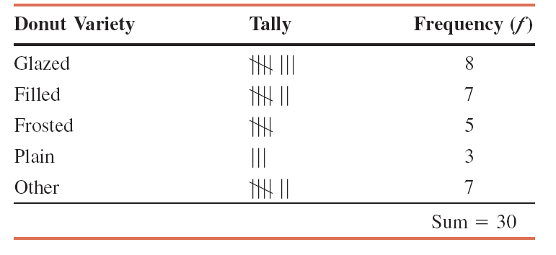
Example 2-1: Solution Table 2.4 Frequency Distribution of Favorite Donut Variety

Slide 12
Relative Frequency and Percentage Distributions (1 of 2)
Calculating Relative Frequency of a Category

Slide 13
Relative Frequency and Percentage Distributions (2 of 2)
Calculating Percentage
Percentage = (Relative frequency) · 100%

Slide 14
Example 2-2
Determine the relative frequency and percentage distributions for the data in Table 2.4.

Slide 15
Example 2-2: Solution Table 2.5 Relative Frequency and Percentage Distributions of Favorite Donut Variety
Donut Variety | Relative Frequency | Percentage
Glazed | 8/30 = .267 | .267 (100) = 26.7
Filled | 7/30 = .233 | .233 (100) = 23.3
Frosted | 5/30 = .167 | .167 (100) = 16.7
Plain | 3/30 = .100 | .100 (100) = 10.0
Other | 7/30 = .233 | .233 (100) = 23.3
 | Sum = 1.000 | Sum = 100%

Slide 16
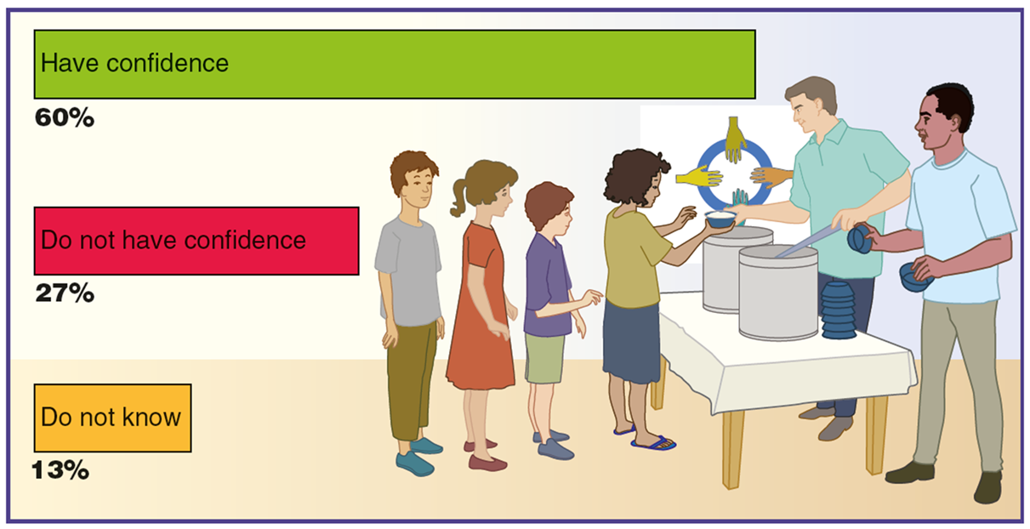
Case Study 2-1 Confidence in Charitable and Nongovernmental Organizations
Source: Data from MOHAMED YOUNIS AND ANDREW RZEPA, One in Three Worldwide Lack Confidence in NGOs, JUNE 20, 2019. Gallup, Inc.

Slide 17
Graphical Presentation of Qualitative Data (1 of 2)
Definition
A graph made of bars whose heights represent the frequencies of respective categories is called a bar graph.

Slide 18
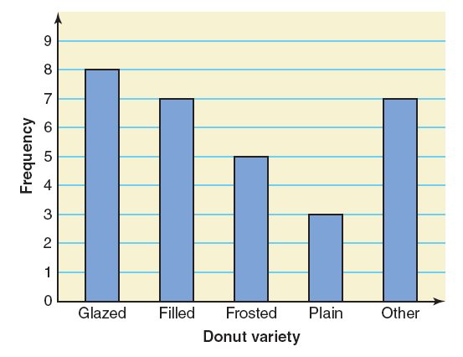
Figure 2.1 Bar Graph for the Frequency Distribution of Table 2.4

Slide 19
Graphical Presentation of Qualitative Data (2 of 2)
Definition
A Pareto chart is a bar graph with bars arranged by their heights in descending order. To make a Pareto chart, arrange the bars according to their heights such that the bar with the largest height appears first on the left side, and then subsequent bars are arranged in descending order with the bar with the smallest height appearing last on the right side.

Slide 20
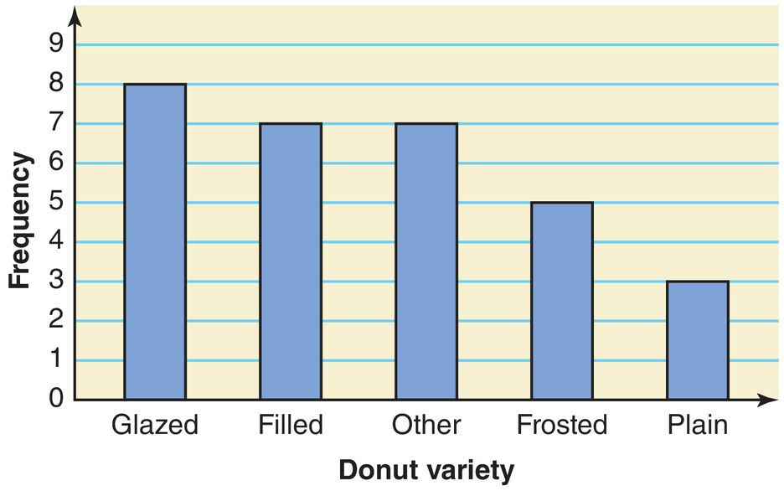
Figure 2.2 Pareto Chart for the Frequency Distribution of Table 2.4

Slide 21
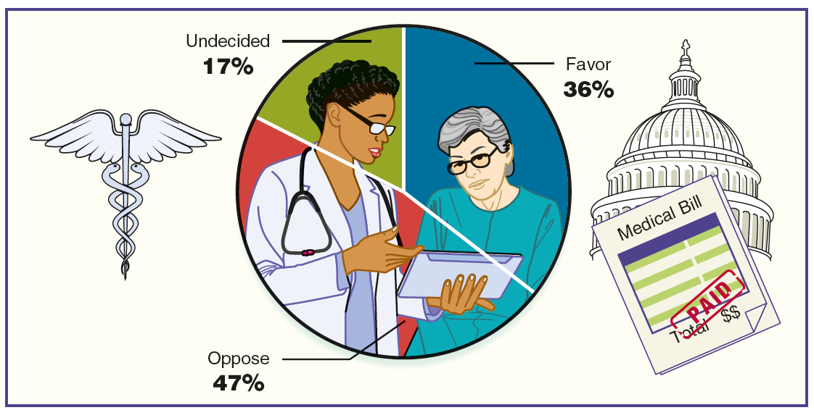
Case Study 2-2 Single-Payer Health Care System Where the Federal Government Provides Coverage for Everyone
Source: Data from Health Care Law, Wednesday, August 07, 2019. Rasmussen Reports, LLC. http://www.rasmussenreports.com/public_content/politics/current_events/healthcare/health_care_law_aug07

Slide 22
Graphical Presentation of Qualitative Data
Definition
A circle divided into portions that represent the relative frequencies or percentages of a population or a sample belonging to different categories is called a pie chart.

Slide 23
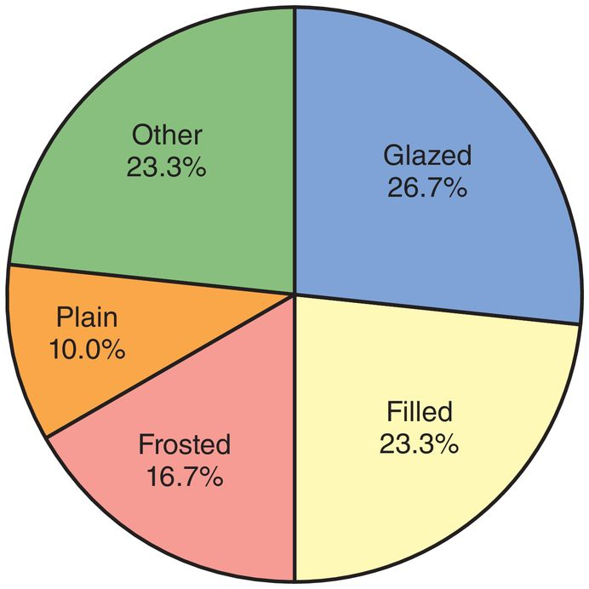
Figure 2.3 Pie Chart for the Percentage Distribution of Table 2.5.

Slide 24
2.2 Organizing and Graphing Quantitative Data
Frequency Distributions
Constructing Frequency Distribution Tables
Relative and Percentage Distributions
Graphing Grouped Data

Slide 25
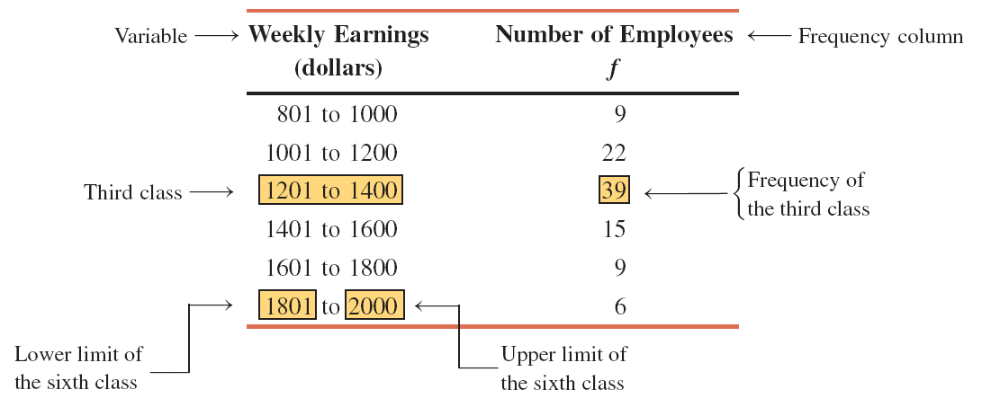
Table 2.6 Weekly Earnings of 100 Employees of a Company

Slide 26
Frequency Distributions for Quantitative Data (1 of 3)
Definition
A frequency distribution for quantitative data lists all the classes and the number of values that belong to each class. Data presented in the form of a frequency distribution are called grouped data.

Slide 27
Frequency Distributions for Quantitative Data (2 of 3)
Finding Class Width
Width of a class = Lower limit of the next class – Lower limit of the current class

Slide 28
Frequency Distributions for Quantitative Data (3 of 3)
Calculating Class Midpoint or Mark

Slide 29
Constructing Frequency Distribution Table
Calculation of Class Width

Slide 30
Table 2.7 Class Widths and Class Midpoints for Table 2.6
Class Limits | Class Width | Class Midpoint
801 to 1000 | 200 | 900.5
1001 to 1200 | 200 | 1100.5
1201 to 1400 | 200 | 1300.5
1401 to 1600 | 200 | 1500.5
1601 to 1800 | 200 | 1700.5
1801 to 2000 | 200 | 1900.5

Slide 31
Example 2-3 (1 of 2)
The following data were collected on the systolic blood pressures of 30 randomly selected adults from a small city. Construct a frequency distribution table.

Slide 32
Example 2-3 (2 of 2)
116 | 132 | 123 | 137 | 125 | 110 | 101 | 129 | 147 | 114
133 | 118 | 107 | 121 | 143 | 120 | 131 | 109 | 127 | 139
111 | 114 | 121 | 130 | 106 | 149 | 124 | 119 | 133 | 127

Slide 33
Example 2-3: Solution
In these data, the minimum value is 101, and the maximum value is 149. Suppose we decide to group these data using five classes of equal width. Then, approximate width of each class = (149 − 101)/5 = 9.6
Now we round this approximate width to a convenient number, say 10. The lower limit of the first class can be taken as 101 or any number less than 101. Suppose we take 101 as the lower limit of the first class. Then our classes will be 101–110, 111–120, 121–130, 131–140, and 141–150

Slide 34
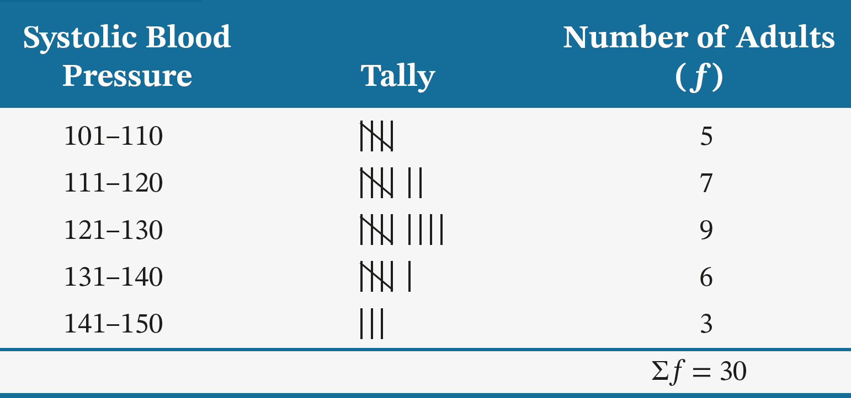
Table 2.8 Frequency Distribution of the Systolic Blood Pressures

Slide 35
Relative Frequency and Percentage Distributions
Calculating Relative Frequency and Percentage

Slide 36
Example 2-4
Calculate the relative frequencies and percentages for Table 2.8.

Slide 37
Example 2-4: Solution Table 2.9 Systolic Blood Pressure of Adults - Constructing Relative Frequency and Percentage Distributions
Systolic Blood Pressure | Relative Frequency | Percentage
101–110 | 5/30 = .167 | 16.7
111–120 | 7/30 = .233 | 23.3
121–130 | 9/30 = .300 | 30.0
131–140 | 6/30 = .200 | 20.0
141–150 | 3/30 = .100 | 10.0
 | Sum = 1.000 | Sum = 100%

Slide 38
Graphing Grouped Data (1 of 2)
Definition
A histogram is a graph in which classes are marked on the horizontal axis and the frequencies, relative frequencies, or percentages are marked on the vertical axis. The frequencies, relative frequencies, or percentages are represented by the heights of the bars. In a histogram, the bars are drawn adjacent to each other.

Slide 39
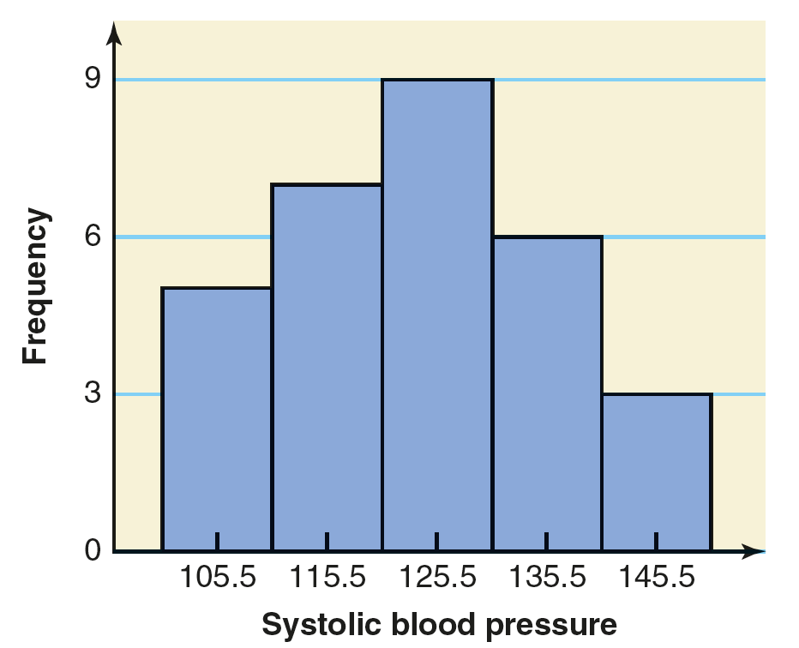
Figure 2.4 Frequency Histogram for Table 2.8

Slide 40
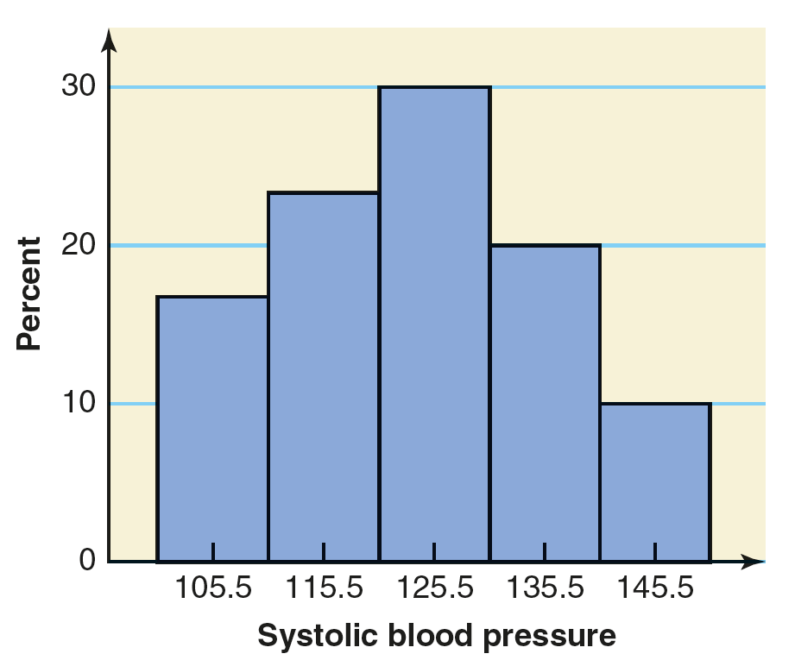
Figure 2.5 Relative Frequency Histogram for Table 2.9

Slide 41
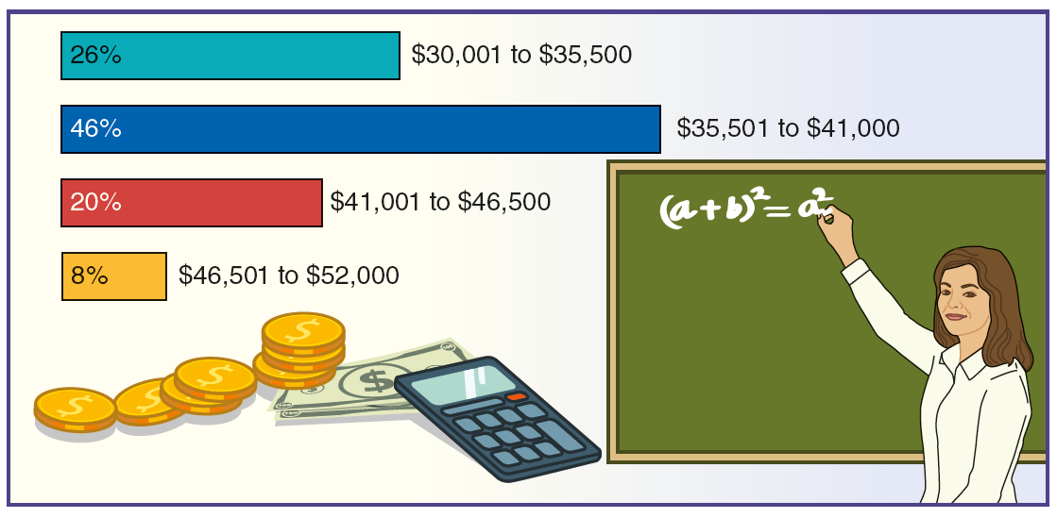
Case Study 2-3 Average Starting Salaries of Teachers
Source: Data from 2017-2018 Average Starting Teacher Salaries by State, National Education Association. http://www.nea.org/home/2017-2018-average-starting-teacher-salary.html

Slide 42
Graphing Grouped Data (2 of 2)
Definition
A graph formed by joining the midpoints of the tops of successive bars in a histogram with straight lines is called a polygon.

Slide 43
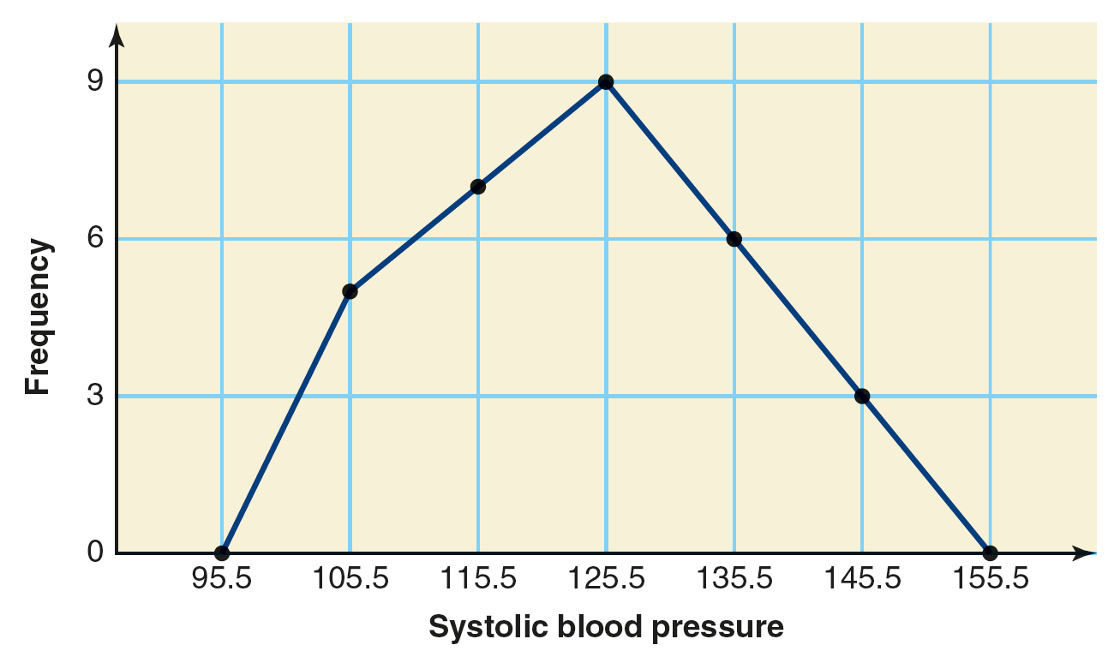
Figure 2.6 Frequency Polygon for Table 2.8

Slide 44
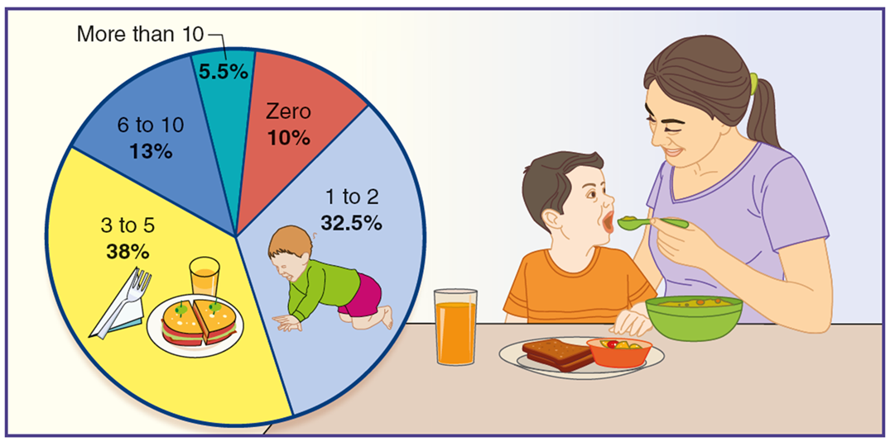
Case Study 2-4 Mom, I Am Hungry
Source: Data from USA TODAY, November 27, 2018.

Slide 45
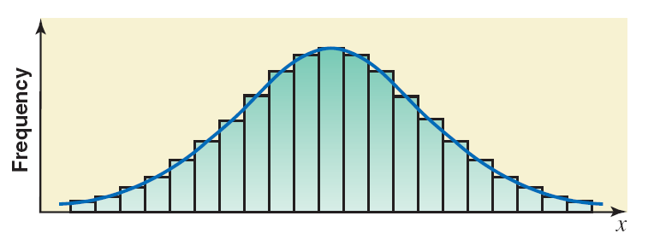
Figure 2.7 Frequency Distribution Curve

Slide 46
Example 2-5 (1 of 2)
The following data give the percentage of adults from 30 small towns who do not have a bank account. Construct a frequency distribution table. Calculate the relative frequencies and percentages for all classes.

Slide 47
Example 2-5 (2 of 2)
18.4 | 9.7 | 24.3 | 3.9 | 14.3 | 22.8 | 12.5 | 7.2 | 13.9 | 20.6
26.7 | 7.7 | 13.4 | 15.4 | 19.3 | 27.3 | 4.7 | 16.3 | 11.6 | 17.7
12.9 | 22.3 | 6.3 | 14.8 | 28.4 | 13.9 | 12.4 | 18.5 | 24.7 | 17.2

Slide 48
Example 2-5: Solution
The minimum value in this data set is 3.9, and the maximum value is 28.4. Suppose we decide to group these data using six classes of equal width. Then,
We round this number to a more convenient number—say 5—and take 5 as the width of each class. We can take the lower limit of the first class equal to 3.9 or any number lower than 3.9. If we start the first class at 0, the classes will be written as 0 to less than 5, 5 to less than 10, and so on. The six classes, which cover all the data values, are recorded in the first column of Table 2.10. The second column in Table 2.10 lists the frequencies of these classes. A value in the data set that is 0 or larger but less than 5 belongs to the first class, a value that is 5 or larger but less than 10 falls into the second class, and so on. The relative frequencies and percentages for classes are recorded in the third and fourth columns, respectively, of Table 2.10. Note that this table does not contain a column of tallies.

Slide 49
Table 2.10 Frequency, Relative Frequency, and Percentage Distributions of the Percent of Adults with No Bank Account
Percentage of Adults with No Bank Account | Frequency | Relative Frequency | Percentage
0 to less than 5 | 2 | .067 | 6.7
5 to less than 10 | 4 | .133 | 13.3
10 to less than 15 | 9 | .300 | 30.0
15 to less than 20 | 7 | .233 | 23.3
20 to less than 25 | 5 | .167 | 16.7
25 to less than 30 | 3 | .100 | 10.0
 | Sum = 30 | Sum = 1.00 | Sum = 100

Slide 50
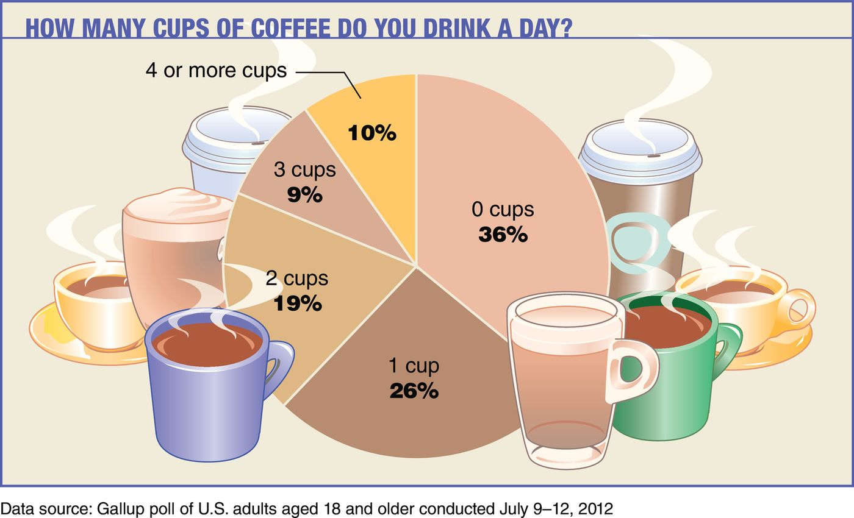
Case Study 2-5 How Many Cups of Coffee Do You Drink a Day?
Data source: Gallup poll of U.S. adults aged 18 and older conducted July 9-12, 2012

Slide 51
Example 2-6
The administration in a large city wanted to know the distribution of vehicles owned by households in that city. A sample of 40 randomly selected households from this city produced the following data on the number of vehicles owned:
5 | 1 | 1 | 2 | 0 | 1 | 1 | 2 | 1 | 1
1 | 3 | 3 | 0 | 2 | 5 | 1 | 2 | 3 | 4
2 | 1 | 2 | 2 | 1 | 2 | 2 | 1 | 1 | 1
4 | 2 | 1 | 1 | 2 | 1 | 1 | 4 | 1 | 3
Construct a frequency distribution table for these data using single-valued classes.

Slide 52
Example 2-6: Solution Table 2.11 Frequency Distribution of Vehicles Owned
Vehicles Owned | Number of Households ( f )
0 | 2
1 | 18
2 | 11
3 | 4
4 | 3
5 | 2
 | Σf = 40
The observations assume only six distinct values: 0, 1, 2, 3, 4, and 5. Each of these six values is used as a class in the frequency distribution in Table 2.11.

Slide 53
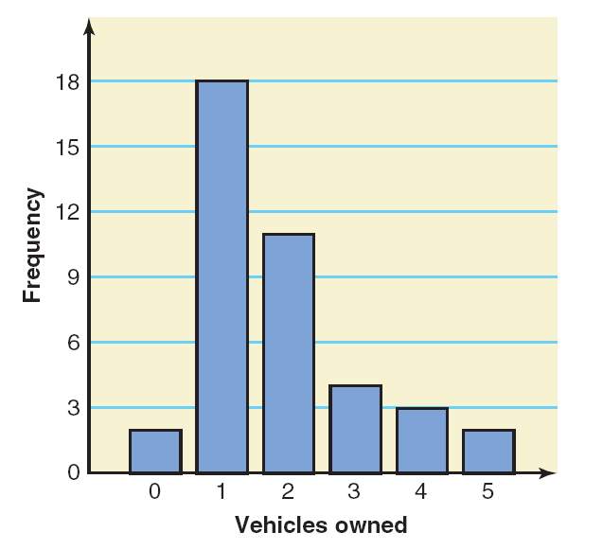
Figure 2.8 Bar Graph for Table 2.11

Slide 54
Cumulative Frequency Distribution
Definition
A cumulative frequency distribution gives the total number of values that fall below the upper boundary of each class.

Slide 55
Example 2-7
Using the frequency distribution of Table 2.8, reproduced here as Table 2.12, prepare a cumulative frequency distribution for the systolic blood pressures of those adults.
Systolic Blood Pressure | Number of Adults ( f )
101–110 | 5
111–120 | 7
121–130 | 9
131–140 | 6
141–150 | 3

Slide 56
Example 2-7: Solution Table 2.13 Cumulative Frequency Distribution of Systolic Blood Pressure of Adults
Class Limits | Cumulative Frequency
101–110 | 5
101–120 | 5 + 7 = 12
101–130 | 5 + 7 + 9 = 21
101–140 | 5 + 7 + 9 + 6 = 27
101–150 | 5 + 7 + 9 + 6 + 3 = 30

Slide 57
Cumulative Frequency Distributions
Calculating Cumulative Relative Frequency and Cumulative Percentage

Slide 58
Table 2.14 Cumulative Relative Frequency and Cumulative Percentage Distributions of Systolic Blood Pressures
Class Limits | Cumulative Relative Frequency | Cumulative Percentage
101–110 | 5/30 = .1667 | 16.67
101–120 | 12/30 = .4000 | 40.00
101–130 | 21/30 = .7000 | 70.00
101–140 | 27/30 = .9000 | 90.00
101–150 | 30/30 = 1.0000 | 100.00

Slide 59
Shapes of Histograms
Symmetric
Skewed
Uniform or Rectangular

Slide 60
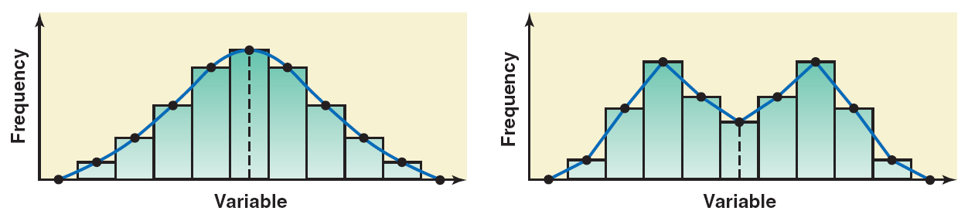
Figure 2.9 Symmetric Histograms

Slide 61
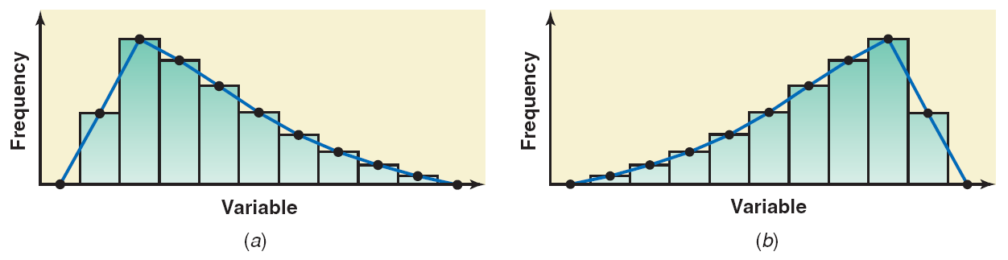
Figure 2.10 (a) A Histogram Skewed to the Right; (b) A Histogram Skewed to the Left

Slide 62
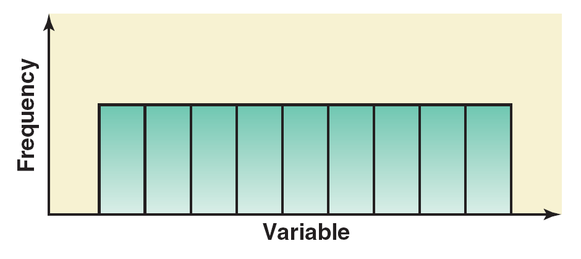
Figure 2.11 A Histogram with Uniform Distribution

Slide 63
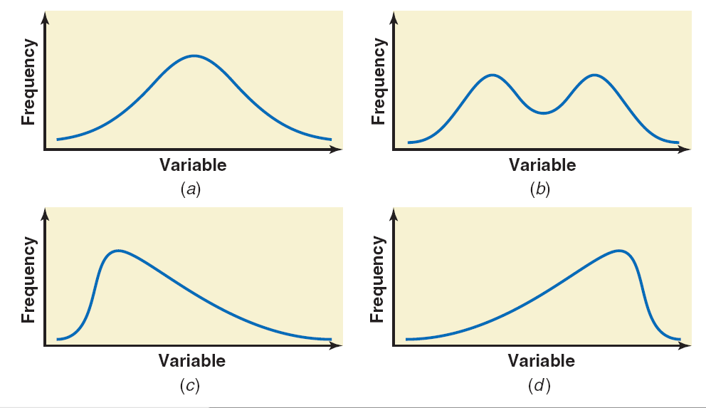
Figure 2.12 (a) and (b) Symmetric Frequency Curves; (c) Frequency Curve Skewed to the Right; (d) Frequency Curve Skewed to the Left

Slide 64
Truncating Axes
Changing the scale either on one or on both axes—that is, shortening or stretching one or both of the axes.
Truncating the frequency axis—that is, starting the frequency axis at a number greater than zero.

Slide 65
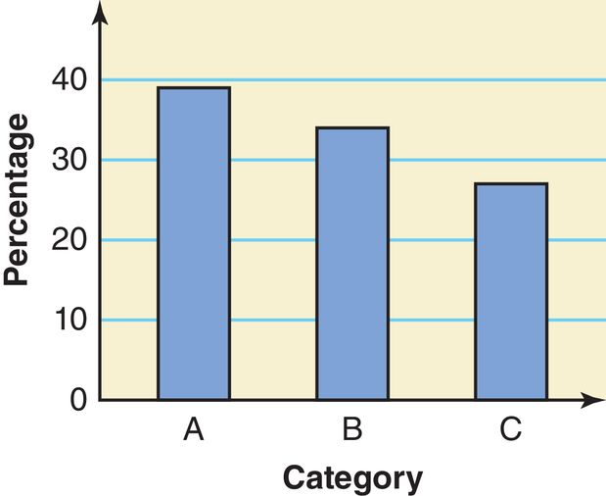
Figure 2.13 Bar Graph without Truncation of the Vertical Axis

Slide 66
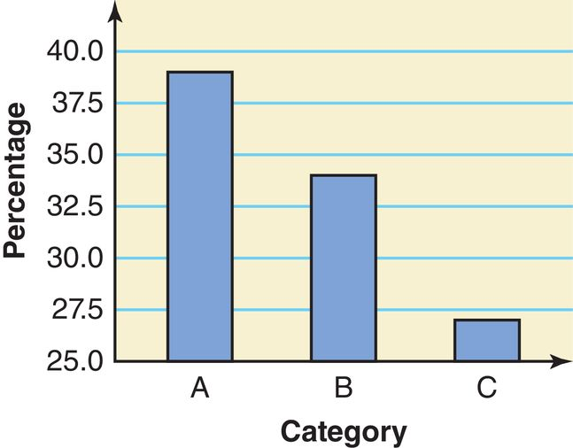
Figure 2.13 Bar Graph with Truncation of the Vertical Axis

Slide 67
2.3 Stem-and-Leaf Displays
Definition
In a stem-and-leaf display of quantitative data, each value is divided into two portions–a stem and a leaf. The leaves for each stem are shown separately in a display.

Slide 68
Example 2-8
The following are the scores of 30 college students on a statistics test:
75 | 52 | 80 | 96 | 65 | 79 | 71 | 87 | 93 | 95
69 | 72 | 81 | 61 | 76 | 86 | 79 | 68 | 50 | 92
83 | 84 | 77 | 64 | 71 | 87 | 72 | 92 | 57 | 98
Construct a stem-and-leaf display.

Slide 69
Example 2-8: Solution (1 of 3)
To construct a stem-and-leaf display for these scores, we split each score into two parts. The first part contains the first digit, which is called the stem. The second part contains the second digit, which is called the leaf. We observe from the data that the stems for all scores are 5, 6, 7, 8, and 9 because all the scores lie in the range 50 to 98.

Slide 70
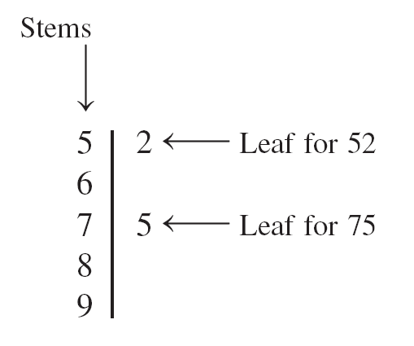
Figure 2.15 Stem-and-Leaf Display

Slide 71
Example 2-8: Solution (2 of 3)
After we have listed the stems, we read the leaves for all scores and record them next to the corresponding stems on the right side of the vertical line. The complete stem-and-leaf display for scores is shown in Figure 2.15.

Slide 72
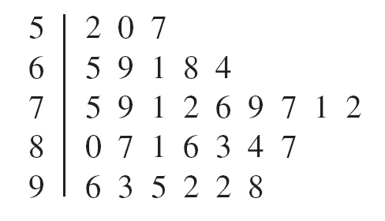
Figure 2.16 Stem-and-Leaf Display of Test Scores

Slide 73
Example 2-8: Solution (3 of 3)
The leaves for each stem of the stem-and-leaf display of Figure 2.16 are ranked (in increasing order) and presented in Figure 2.17.

Slide 74
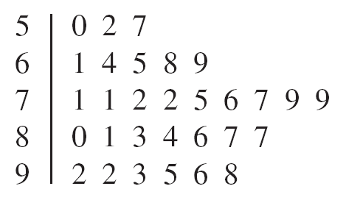
Figure 2.17 Ranked Stem-and-Leaf Display of Test Scores
One advantage of a stem-and-leaf display is that we do not lose information on individual observations.

Slide 75
Example 2-9
The following data give the monthly rents paid by a sample of 30 households selected from a small town.
880 | 1081 | 721 | 1075 | 1023 | 775 | 1235 | 750 | 965 | 960
1210 | 985 | 1231 | 932 | 850 | 825 | 1000 | 915 | 1191 | 1035
1151 | 630 | 1175 | 952 | 1100 | 1140 | 750 | 1140 | 1370 | 1280
Construct a stem-and-leaf display for these data.

Slide 76
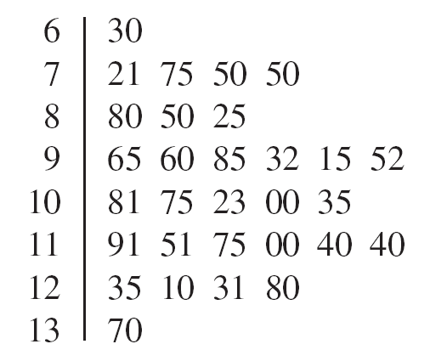
Example 2-9: Solution Figure 2.18 Stem-and-Leaf Display of Rents

Slide 77
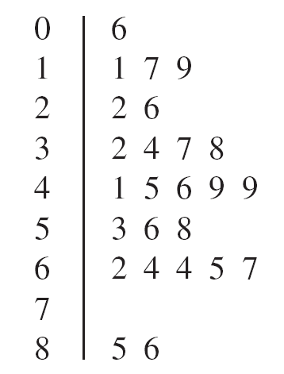
Example 2-10
The following stem-and-leaf display is prepared for the number of hours that 25 students spent working on computers during the last month.
Prepare a new stem-and-leaf display by grouping the stems.

Slide 78
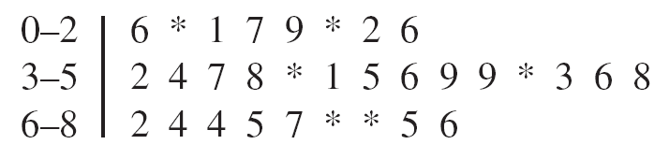
Example 2-10: Solution Figure 2.19 Grouped Stem-and-Leaf Display

Slide 79
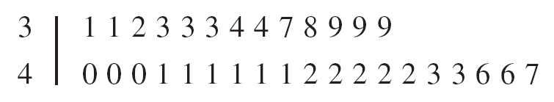
Example 2-11
Consider the following stem-and-leaf display, which has only two stems. Using the split stem procedure, rewrite the stem-and-leaf display.

Slide 80
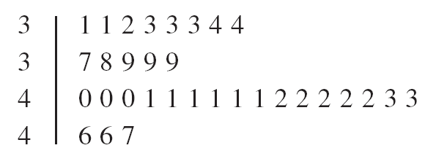
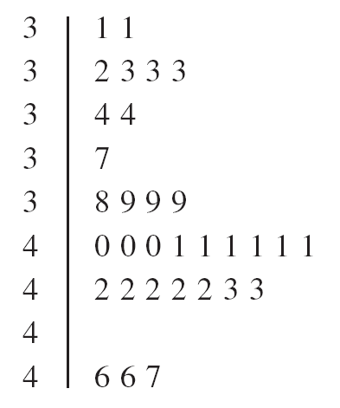
Example 2-11: Solution Figure 2.20 & 2.21 Split Stem-and-Leaf Display

Slide 81
2.4 Dotplots
Definition
Values that are very small or very large relative to the majority of the values in a data set are called outliers or extreme values.

Slide 82
Example 2-12
A statistics class that meets once a week at night from 7:00 PM to 9:45 PM has 33 students. The following data give the ages (in years) of these students. Create a dotplot for these data.
34 | 21 | 49 | 37 | 23 | 22 | 33 | 23 | 21 | 20 | 19
33 | 23 | 38 | 32 | 31 | 22 | 20 | 24 | 27 | 33 | 19
23 | 21 | 31 | 31 | 22 | 20 | 34 | 21 | 33 | 27 | 21

Slide 83
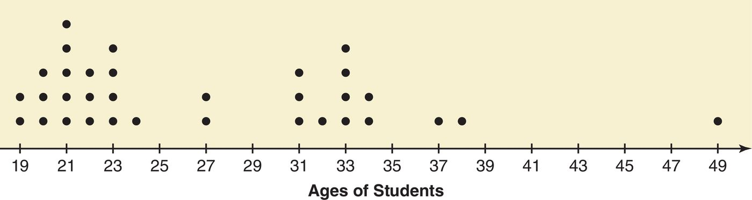
Example 2-12: Solution (1 of 2)
Step1. Draw a horizontal line with numbers that cover the given data as shown in Figure 2.22
Step 2. Place a dot above the value on the numbers line that represents each of the ages listed above. After all the dots are placed, Figure 2.23 gives the complete dotplot.

Slide 84
Example 2-12: Solution (2 of 2)
As we examine the dotplot of Figure 2.23, we notice that there are two clusters (groups) of data. Eighteen of the 33 students (which is almost 55%) are 19 to 24 years old, and 10 of the 33 students (which is about 30%) are 31 to 34 years old. There is one student who is 49 years old and is an outlier.

Slide 85
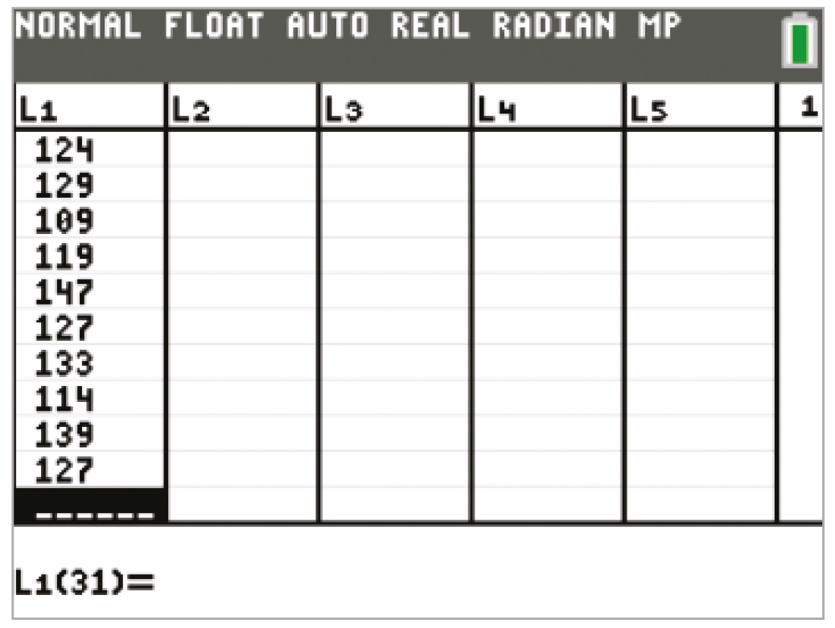
TI-84 Color/TI-84 (1 of 4)

Slide 86
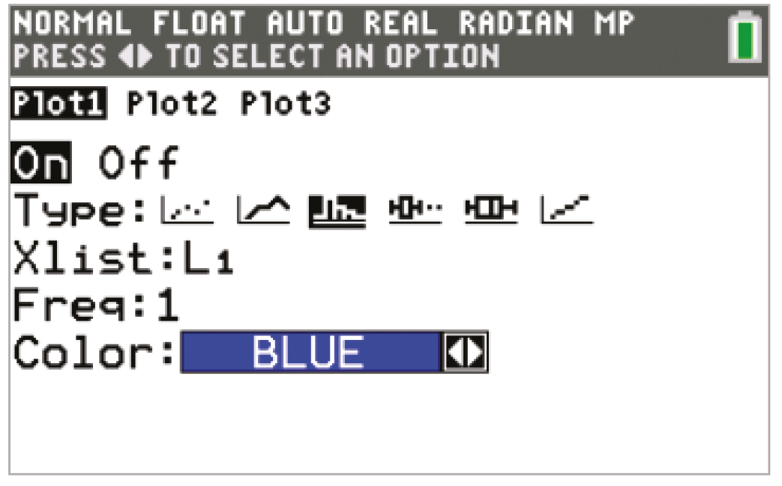
TI-84 Color/TI-84 (2 of 4)

Slide 87
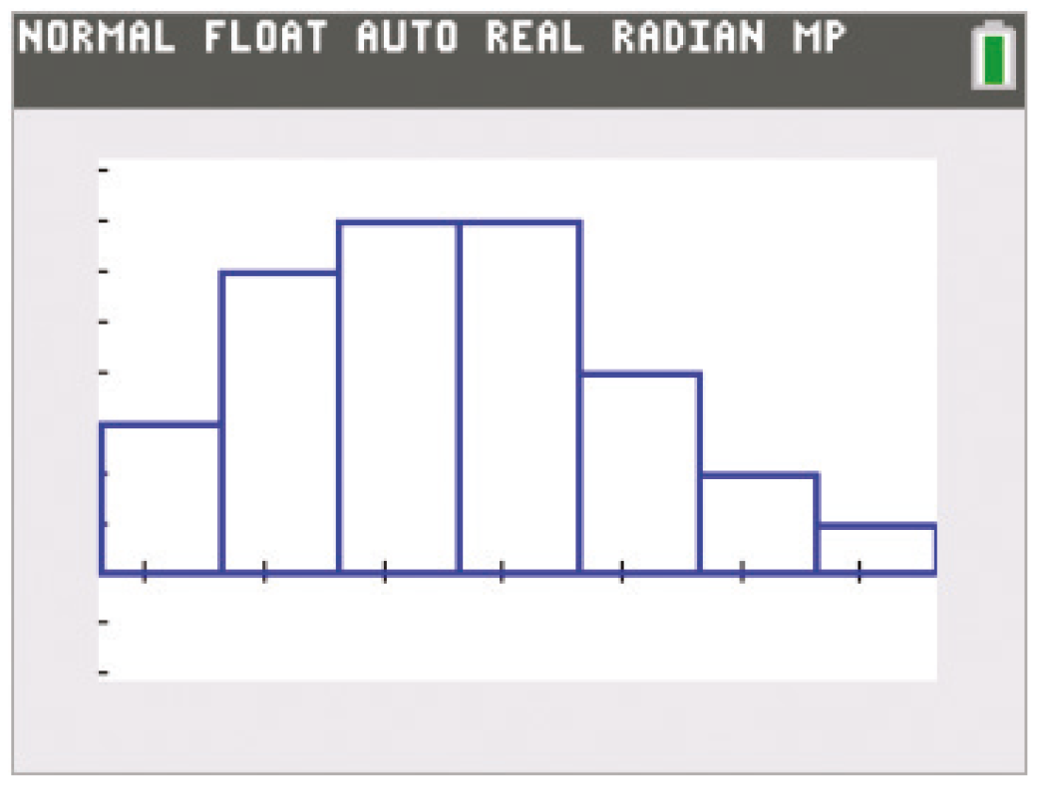
TI-84 Color/TI-84 (3 of 4)

Slide 88
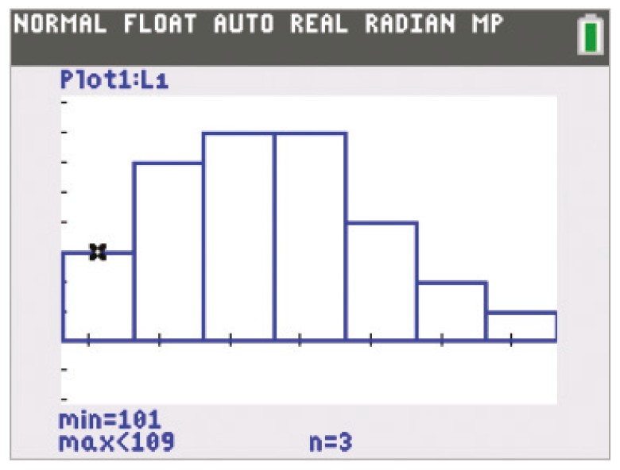
TI-84 Color/TI-84 (4 of 4)

Slide 89
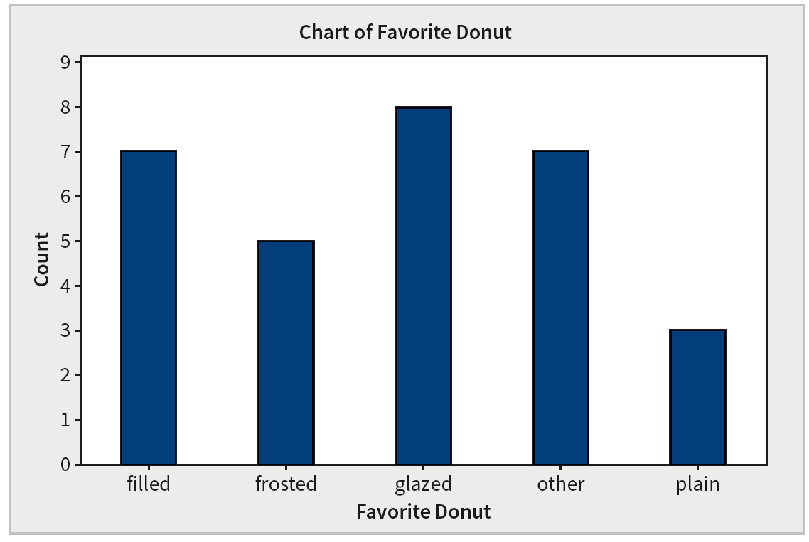
Minitab (1 of 5)

Slide 90
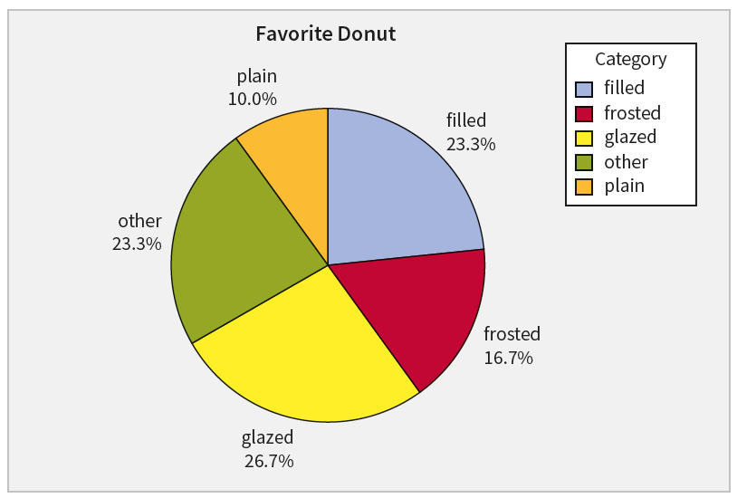
Minitab (2 of 5)

Slide 91
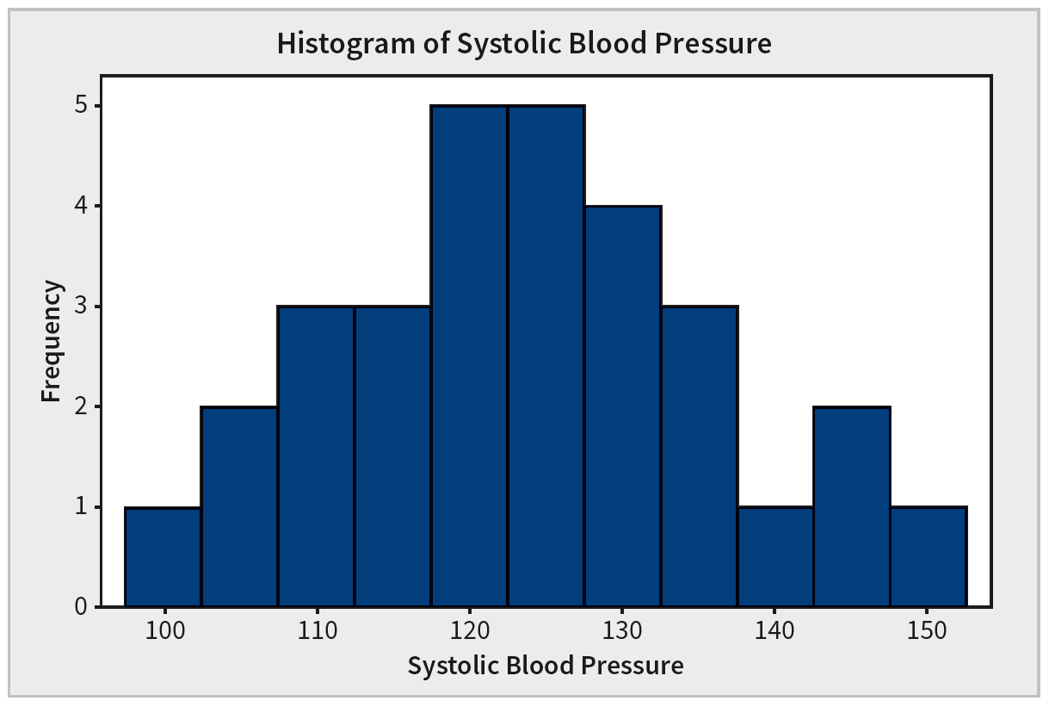
Minitab (3 of 5)

Slide 92
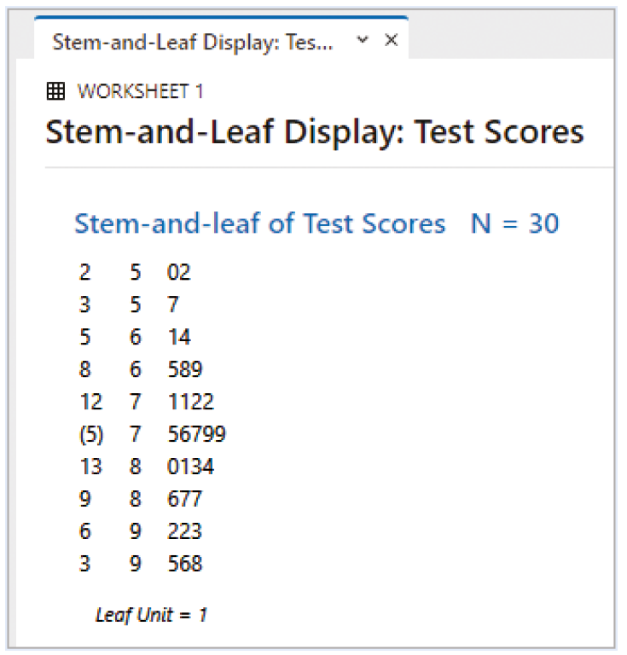
Minitab (4 of 5)

Slide 93
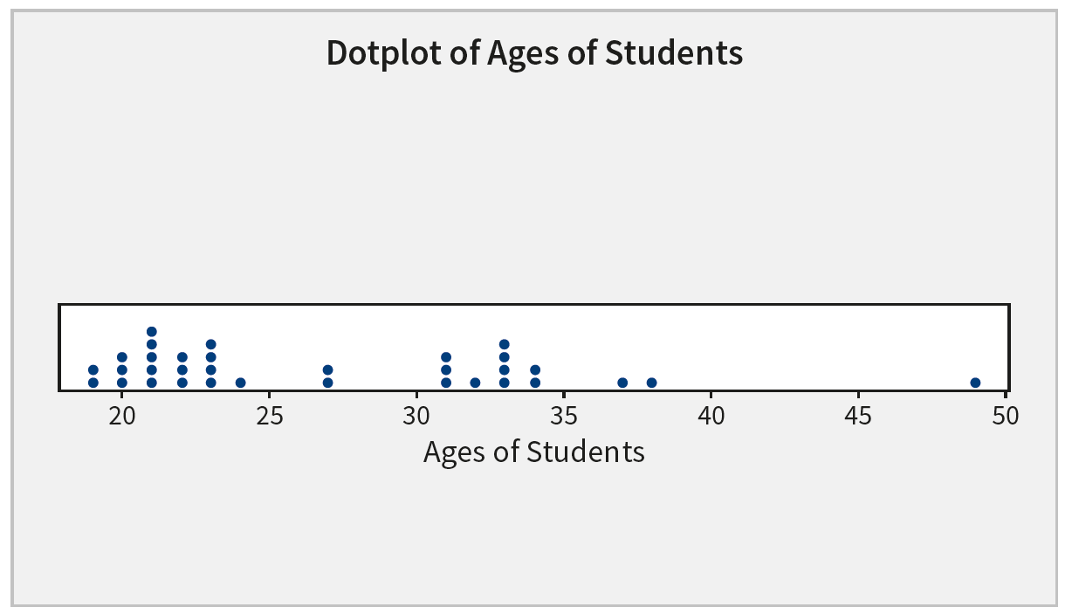
Minitab (5 of 5)

Slide 94
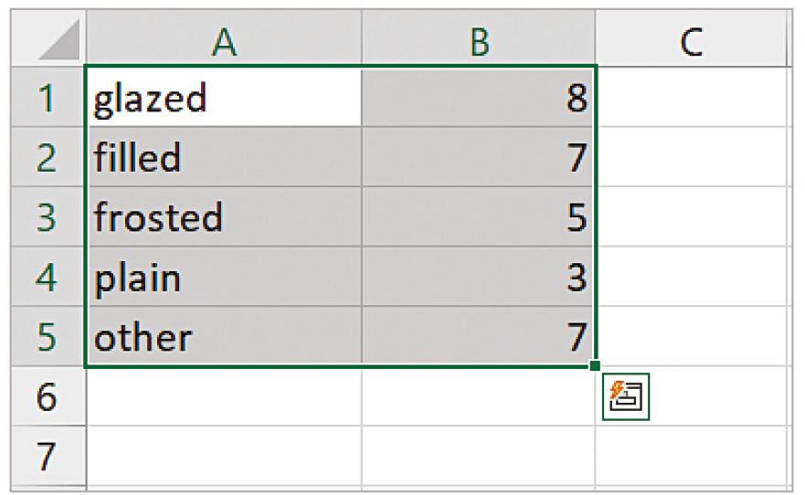
Excel (1 of 3)

Slide 95
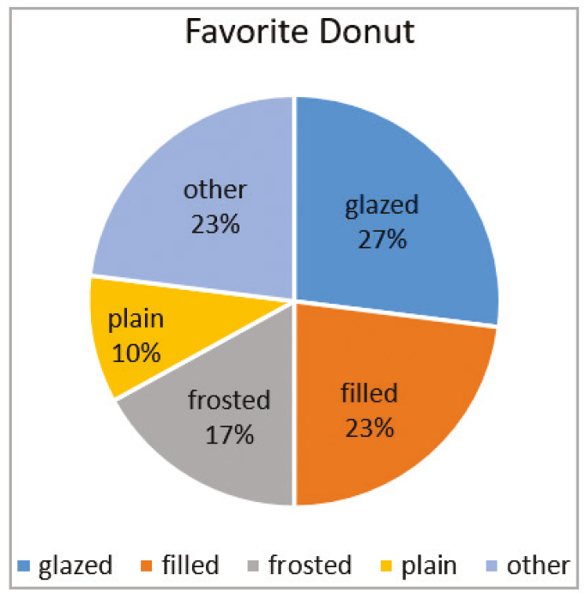
Excel (2 of 3)

Slide 96
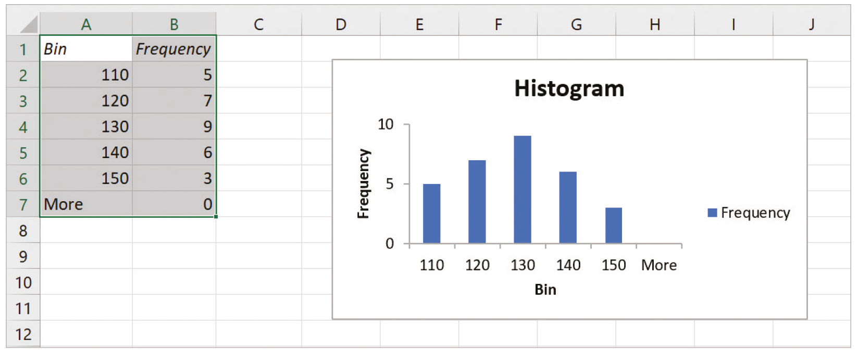
Excel (3 of 3)

Slide 97
Copyright
Copyright © 2021 John Wiley & Sons, Inc.
All rights reserved. Reproduction or translation of this work beyond that permitted in Section 117 of the 1976 United States Act without the express written permission of the copyright owner is unlawful. Request for further information should be addressed to the Permissions Department, John Wiley & Sons, Inc. The purchaser may make back-up copies for his/her own use only and not for distribution or resale. The Publisher assumes no responsibility for errors, omissions, or damages, caused by the use of these programs or from the use of the information contained herein.

